Slide 1
Presentation BoD Candidates
General Major
Oleg Botsman
Russia

Slide 2


INTERNATIONAL MILITARY SPORTS COUNCIL
Major General Oleg Botsman
(RUSSIA)
CANDIDATE TO THE CISM BOARD OF DIRECTORS
FROM EUROPE
Sri Lanka, Colombo
20 May 2025

Slide 3
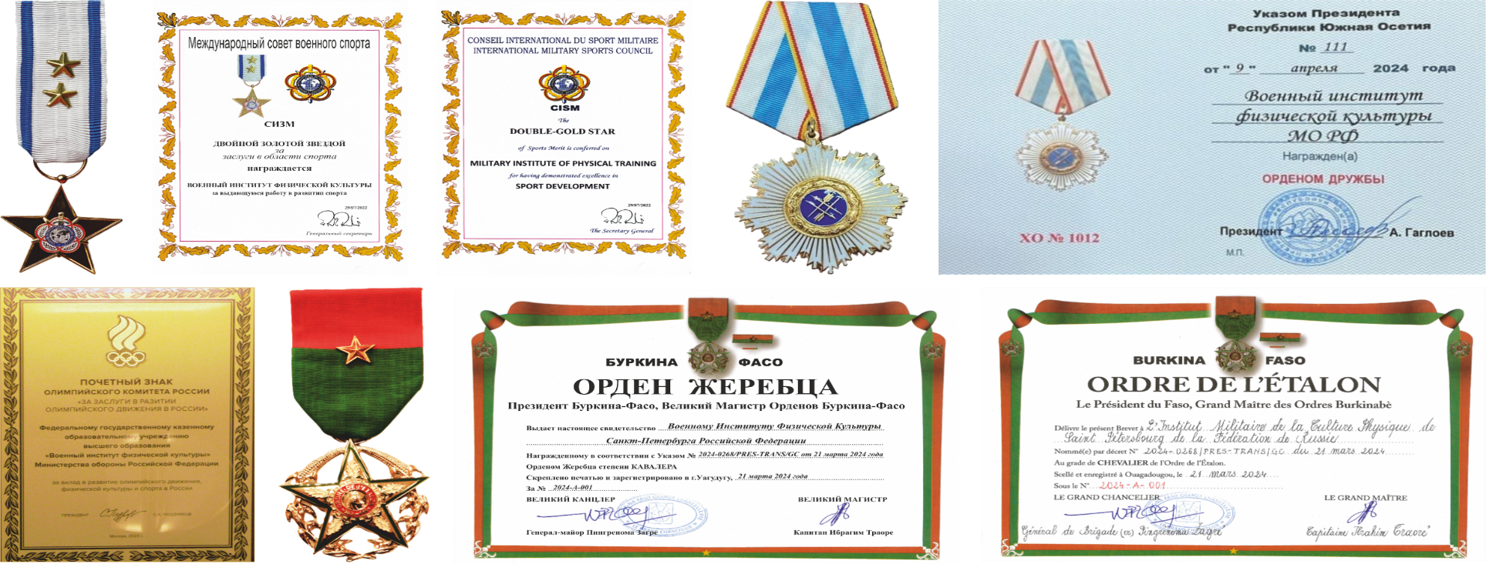
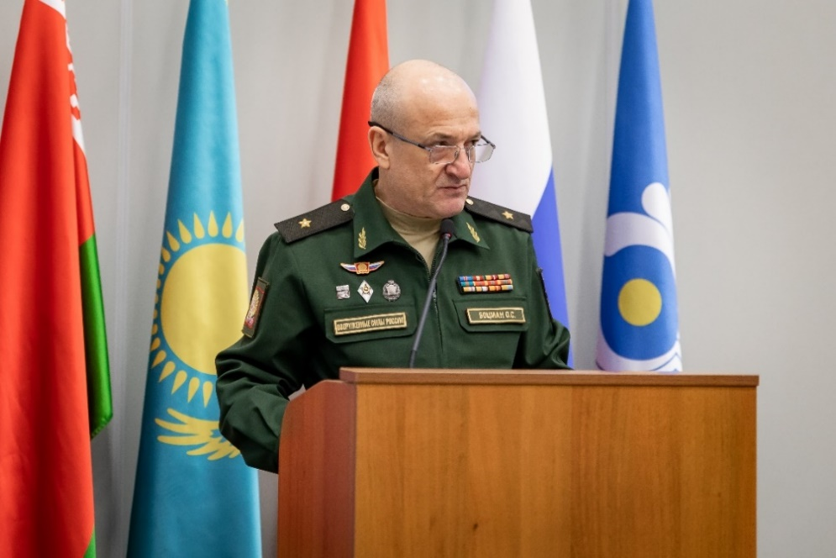
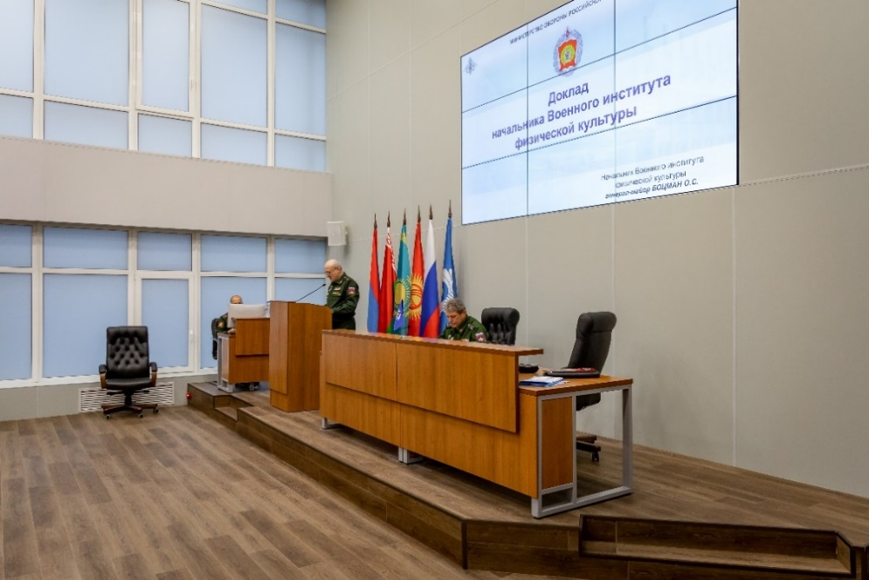
ACTIVITIES IN THE RUSSIAN FEDERATION

Slide 4

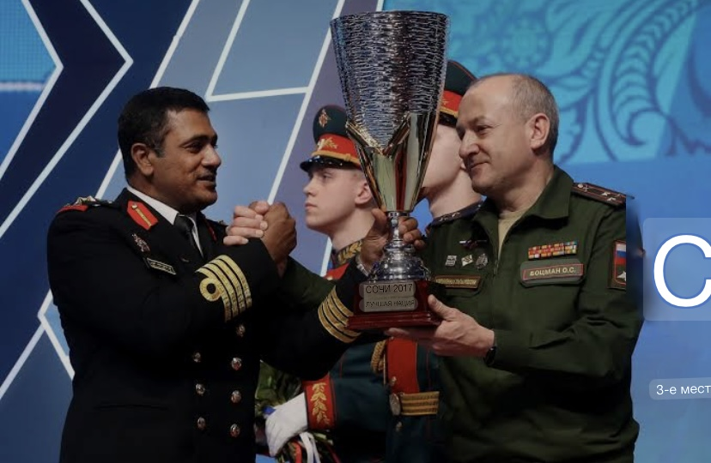
ORGANISING WORLD-CLASS SPORTING EVENTS IN CISM SPORTS
ON THE TERRITORY OF THE RUSSIAN FEDERATION
from 2012 to 2018
40th Military Parachuting World Championship (Kubinka, 2016)
International Military Pentathlon Tournament (Moscow, 2017)
1st Military Indoor Climbing World Championship (Moscow, 2018)
50th Military Swimming and Lifesaving World Championship (Samara, 2018)
33rd Military Wrestling World Championship (Moscow, 2018)
3rd CISM World Winter Games, Sochi, 2017

Slide 5
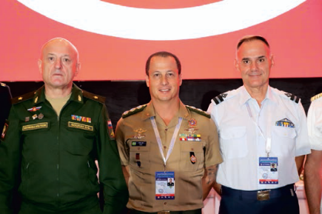
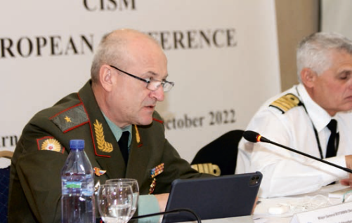
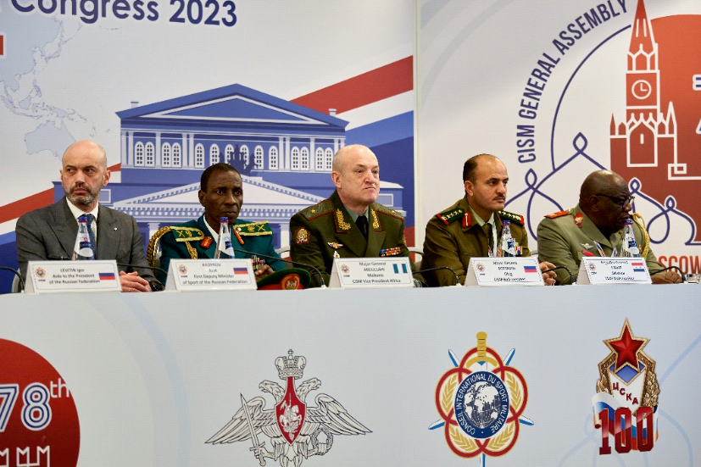
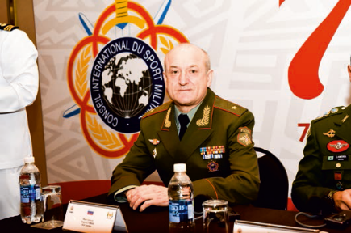
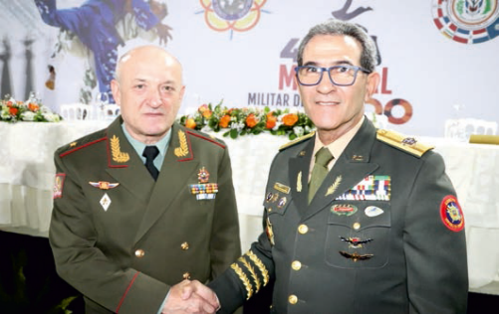
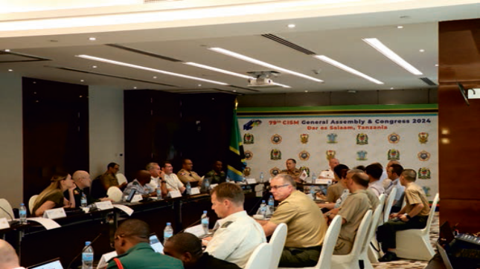
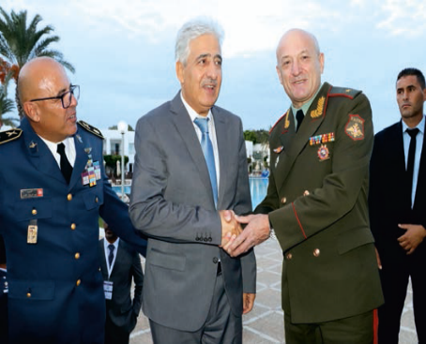
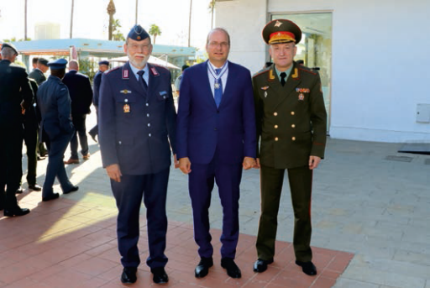
MEMBER OF CISM BOARD OF DIRECTORS FROM EUROPE

Slide 6
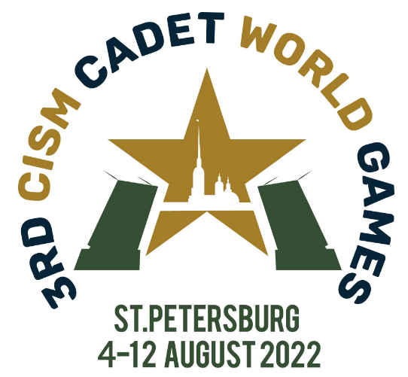

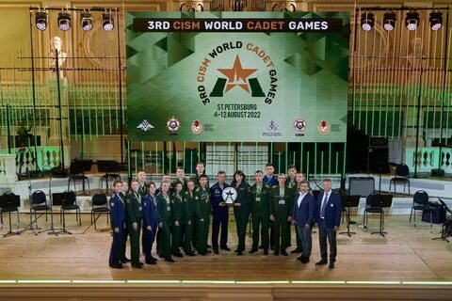
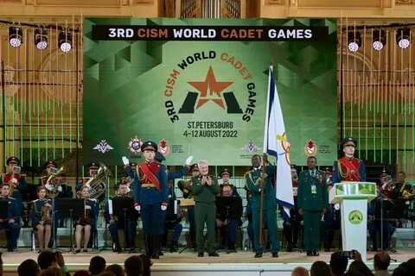
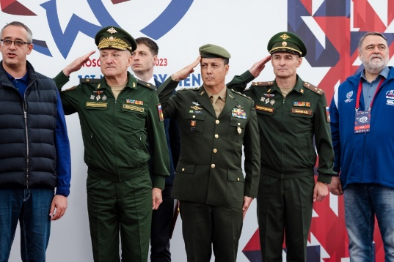
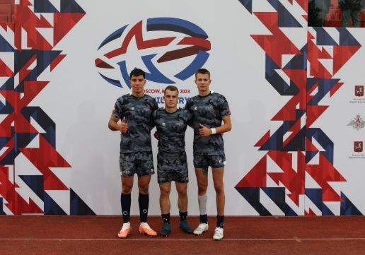
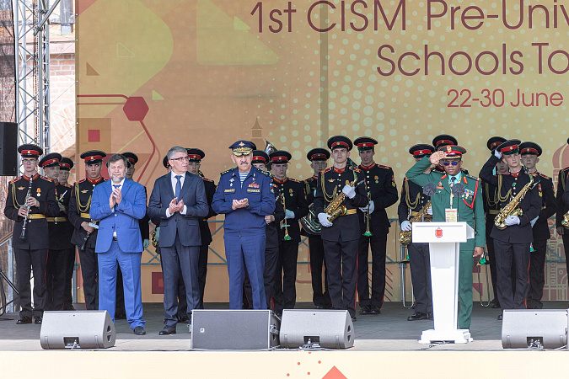
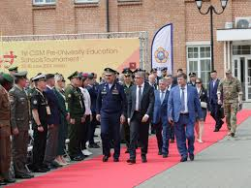


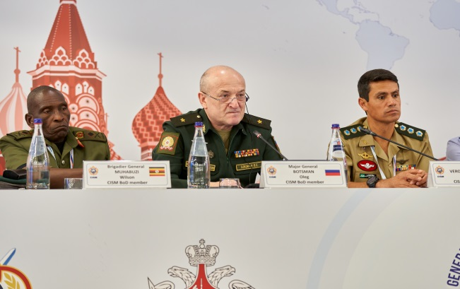
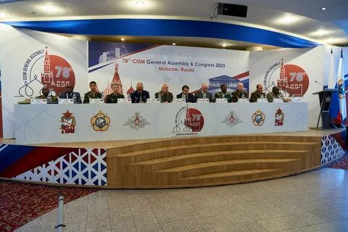
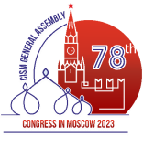
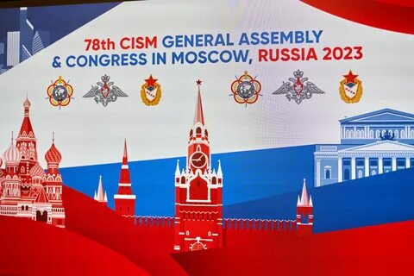
EXPERIENCE OF CISM EVENTS IN THE RUSSIAN FEDERATION
3rd World Cadet Games, St. Petersburg, 2022
1st Military Men's Rugby-7 Challenge,
Moscow, 2023
1st CISM Pre-University Educational Schools Tournament,Tula, 2024
78th CISM General Assembly and Congress, Moscow 2023

Slide 7



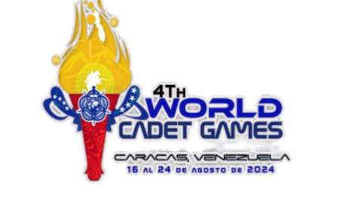

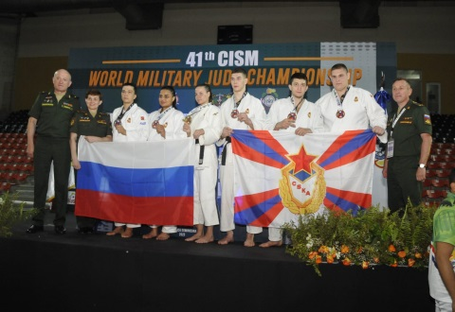
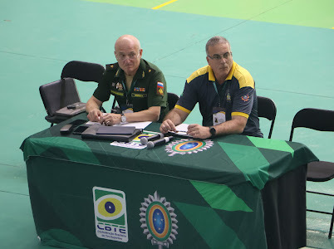
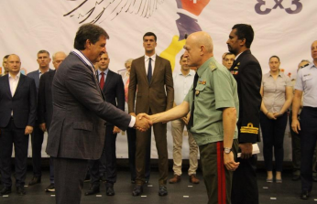
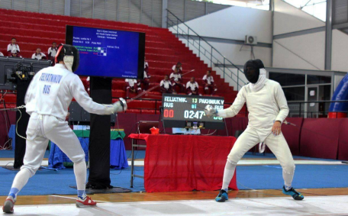
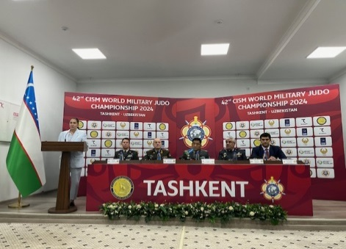
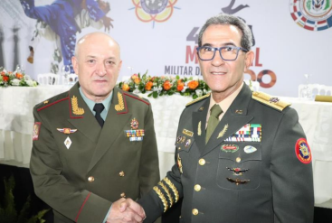
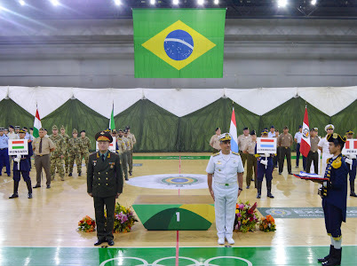
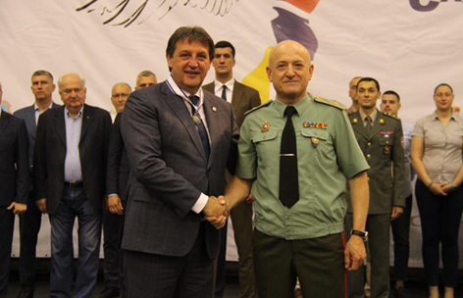
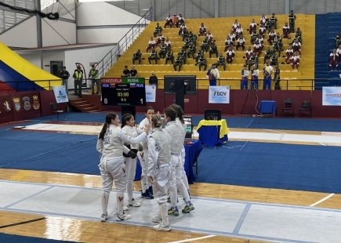
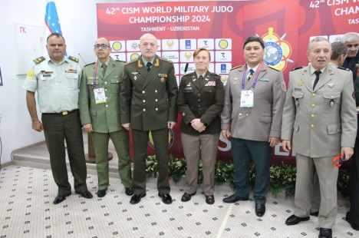
OFFICIAL CISM REPRESENTATIVE
41st WMC
JUDO
Santo Domingo,
Dominican Republic, 2023
54TH WMC Shooting
Rio de Janeiro, Brazil, 2023
3rd WMC BASKETBALL 3*3
Novi Sad, Serbia, 2024
4TH CISM WORLD CADET GAMES 2024
Caracas, Venezuela, 2024
42ND WMC
JUDO
Tashkent, Uzbekistan, 2024

Slide 8
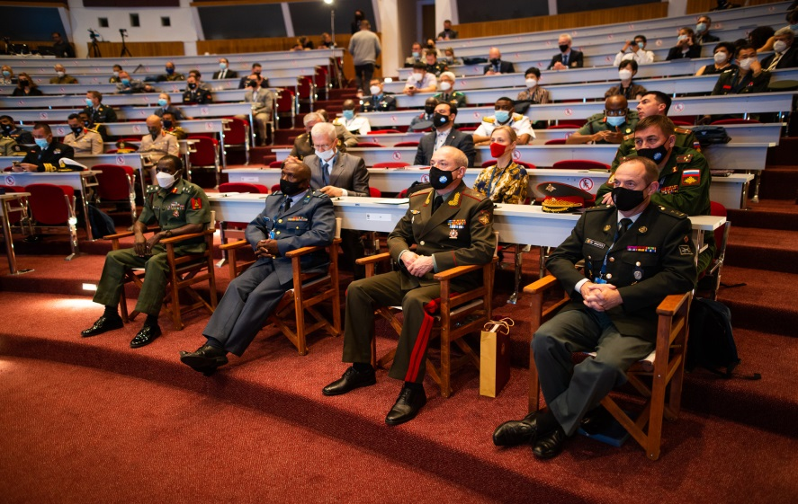

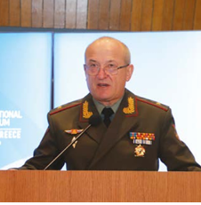
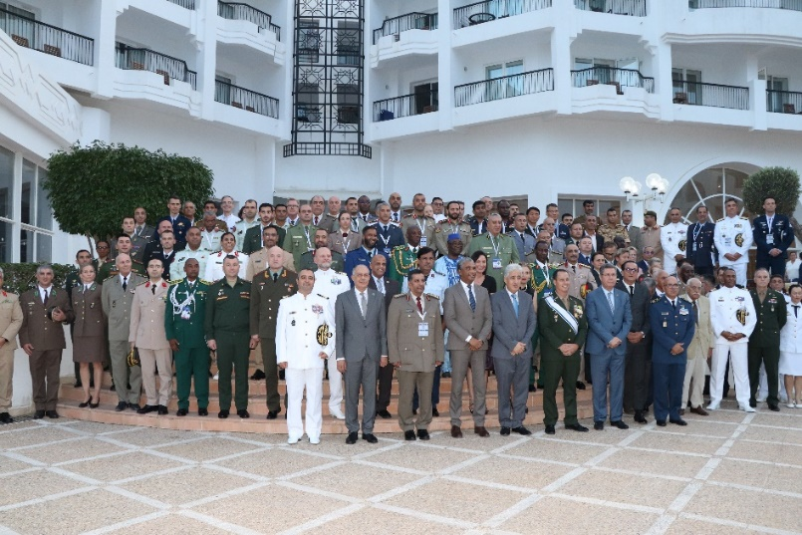
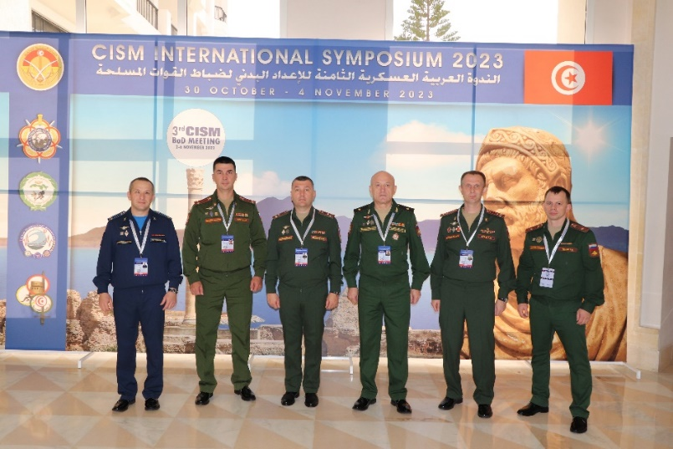

CISM International Symposium, Greece, 2021
PARTICIPATION IN CISM INTERNATIONAL SYMPOSIUMS
CISM International Symposium, Tunisia, 2023

Slide 9
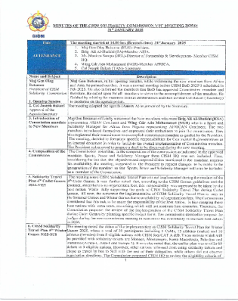


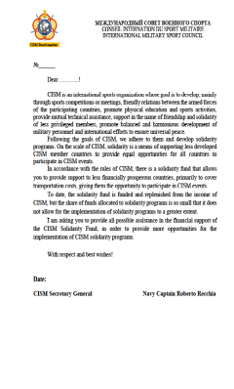

PRESIDENT OF CISM SOLIDARITY COMMISSION
COMMISSION MEETINGS
TRAVEL PLAN
WINTER GAMES
SOLIDARITY
FUND
SOLIDARITY
TROPHEY
FRIENDSHIP THOUGH SPORT
FRIENDSHIP THOUGH SPORT
FRIENDSHIP THOUGH SPORT
FRIENDSHIP THOUGH SPORT

Slide 10
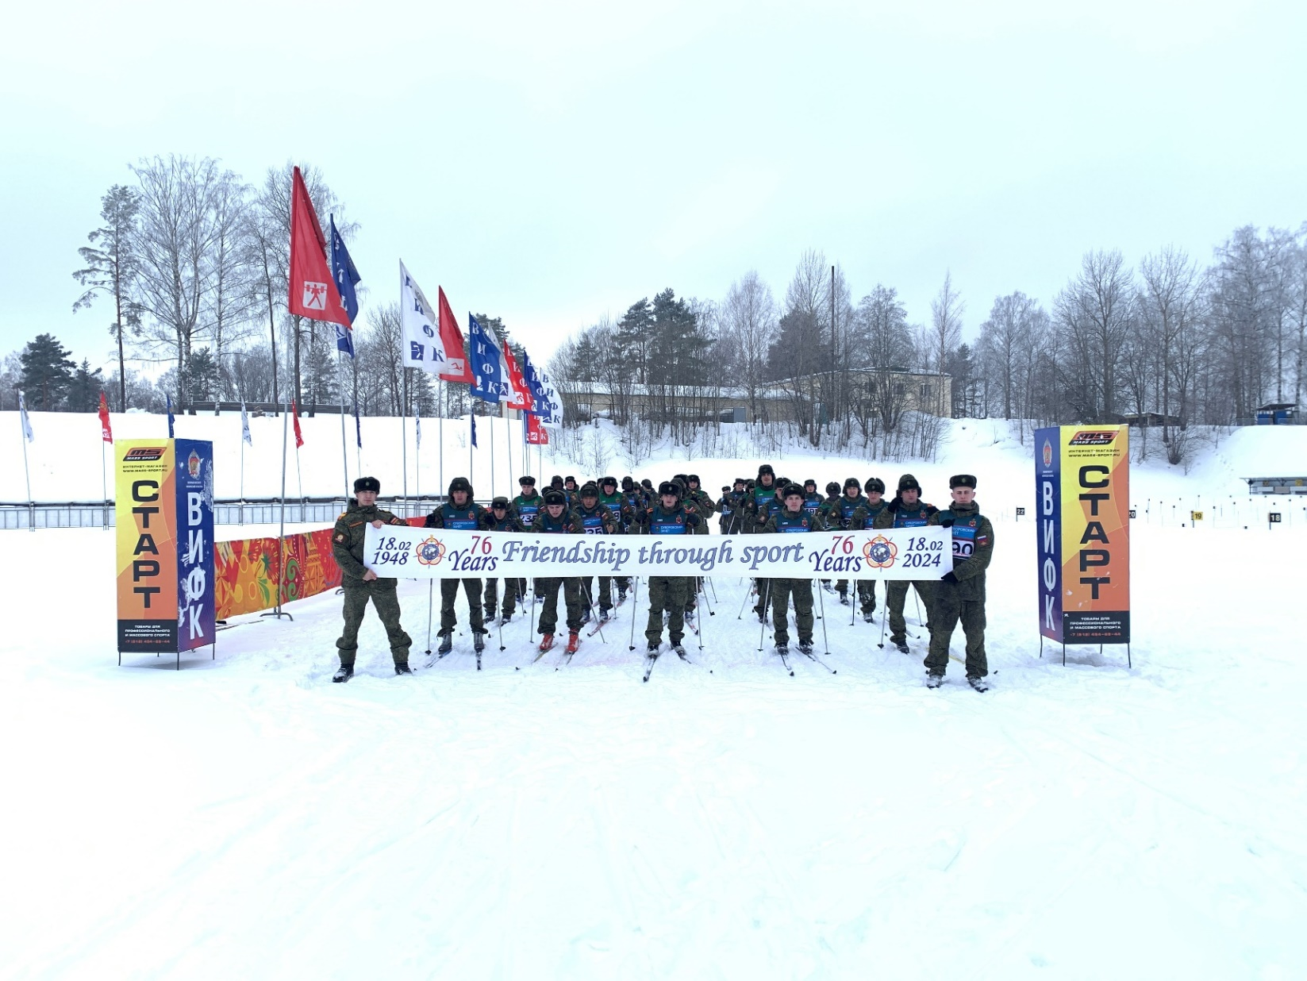
INTERNATIONAL MILITARY SPORTS COUNCIL

Slide 11
THANK YOU FOR YOUR ATTENTION
Friendship through sport!

Slide 12
Presentation BoD Candidates
Lt Colonel
Christian Lützkendorf
Germany

Slide 13
Board of Directors Elections 2025 – 2029
Candidate
Lieutenant Colonel
Christian Lützkendorf
Germany

Slide 14
Curriculum Vitae
Lieutenant Colonel Christian Lützkendorf
Periode | Task performed
2019 - today | Chief of the German Delegation to CISM, Deputy Head of Sports Department Armed Forces Office
2016 - 2019 | Operations staff officer for occupational health management Bundeswehr Medical Service Headquarters
2013 - 2016 | Training company commander and deputy for the head of the Training and Education Division at the Bundeswehr Sports School
2012 - 2013 | Chief of the group "Sports Therapy after Deployment-related Impairment of Health" at the Bundeswehr Sports School
2011 - 2012 | Operations officer and deputy for the squadron commander of the Air Force Force Protection Regiment
2009 - 2011 | Platoon commander with the Air Force Force Protection Regiment including Deployment to Afghanistan
2008 - 2009 | Advanced officer training and military specialist training
2004 - 2008 | Studies in sport sciences (diploma) at the University of the Bundeswehr in Munich
2003 - 2004 | Officer training at the Air Force Officer School
1983 | Year of Birth
Notes:
Film-Intro. Auf einer Fläche von 40 Hektar befinden sich u. a. ein Fußball- und Leichtathletikstadion mit Flutlichtanlage für 8.000 Zuschauer, zwei Schwimmhallen mit bis zu 600 Zuschauerplätzen, eine Leichtathletikhalle sowie viele weitere Hallen, (z.B Halle 500 Zuschauer), Sportplätze und Spielfelder.

Slide 15
Commitment to CISM
Additional qualifications in the field of sport
Membership in CISM Commissions and Working Groups
2021 - today | Member of CISM Sport Science Commission
2023 - today | Member of CISM Para Sport Working Group
2024 - today | Member of CISM Sport Commission Triathlon
Additional qualifications in the field of sport
2008 | Sports instructor C in various sports
2008 | Training instructor for endurance and fitness sports
2011 | Instructor and training officer
2013 | Sports officer
2014 | Instructor for military fitness
2015 | Sports instructor B, Sports in Prevention (profile: posture and movement and cardiovascular system)
2017 | Specialist for occupational health management (IHK)
2017 | Occupational health manager (IHK)
Notes:
Film-Intro. Auf einer Fläche von 40 Hektar befinden sich u. a. ein Fußball- und Leichtathletikstadion mit Flutlichtanlage für 8.000 Zuschauer, zwei Schwimmhallen mit bis zu 600 Zuschauerplätzen, eine Leichtathletikhalle sowie viele weitere Hallen, (z.B Halle 500 Zuschauer), Sportplätze und Spielfelder.

Slide 16
Presentation BoD Candidates
Lt Colonel
Jan van den Dool
Netherlands
(no Presentation)

Slide 17
Presentation BoD Candidates
Captain
Nicholas Milne
France
(no Presentation)

